Slide 1
FTE Application-SWE Name: Zhiqiang Zhou Date: 8/22 2016

Slide 2
Agenda
Metrics to Represent in Dashboard
Dashboard Demonstration
Workflow Introduction
Q & A

Slide 3
Data Funnel (July)
WEDCS Visitors
2.9m (100%)
6.5k (0.23%)
Contribution Link Clickers
PR Initiators
111 (<0.01%)
106 (<0.01%)
Accepted

Slide 4
Key Metrics
Publish
A
Actions (Create/Delete/Update/Rename) on one or more topics.
Pull Request
Contribution & Contributors
A mechanism for proposing and collaborating on changes to a repository.
B
C
People who make a commit, open an issue or propose a pull request.

Slide 5
Common Items to Represent
Per day/month trend and accumulated number for each key metric
Categorized by repository name, tenant, site
The time range for all items are configurable by a time slicer

Slide 6
Publish Categorization
The number of topics updated in a single publish.
Topic
The action of the user for a single topic: create, deleted, updated, rename or not explicitly known.
Action
The number of changing code lines (insertions or deletions) of a single topic when a user action happens.
Code Lines

Slide 7
Pull Request Categorization
The number of commits in a single pull request.
Commit
The status of a single pull request: successfully merged, rejected or being active now.
Status
The time duration for a single pull request from being created to being merged.
Duration

Slide 8
DASHBOARD
DEMONSTRATION

Slide 9



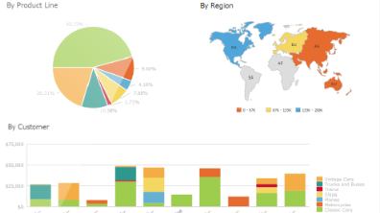
Workflow
STAGE ONE
STAGE TWO
STAGE THREE
STAGE FOUR
Extracting Data
Parsing Data
Loading Data
Visualizing Data
By calling Rest API, acquiring the JSON data from GitHub and Visual Studio Online.
Parsing the JSON data to get the information we need.
Inserting the information to the tables created in the database.
Make the data visualized in dashboard by PowerBI.

Slide 10
Backend Jobs
Gather data that is missed
Pull request of VSO repositories
Complement the incomplete data
Localization
Design algorithm to get metrics can’t directly obtained by parsing JSON data
Count of changed words

Slide 11
THANK YOU
FOR LISTENING

Slide 12
Q & A

